Slide 1
Becoming a state
Lesson 7 – The early history of Michigan
I can describe the relationship between the erie canal, increased population, and Michigan’s statehood.

Slide 2
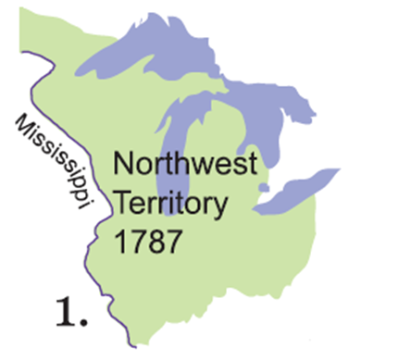
The early days
Michigan was part of the Northwest Territory (a huge piece of land) which was owned by the United States
It was intended that this territory would be divided into smaller territories which would become states.
As historians, we have to ask about the 5 W’s to learn how Michigan became a state about 200 years ago!
What could we construct to show the events that occurred that led up to Michigan becoming a state?

Slide 3
Timeline – the road to becoming a state
White Paper – 12 x 18”
Set of timeline cards – cut out and in chronological order
Pencil
Glue stick
Draw a winding road across your paper to construct a timeline.
Give your timeline a title: The Road to Becoming a State

Slide 4
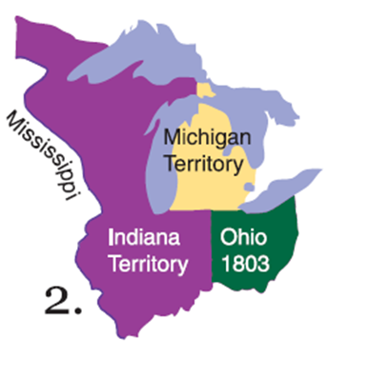
1805 - Michigan becomes its own territory
Some of the Upper Peninsula was not part of the Michigan territory
Other states like Ohio had become their own territory before Michigan
People were already thinking about how Michigan could be a state

Slide 5
What did Michigan need to become a state?
Enough people to become a state – 60,000!
Michigan only had 5,000 people – definitely NOT enough! ☹
This was not good news for Michigan.

Slide 6
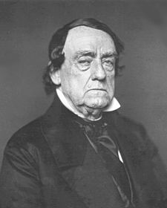
Michigan needed a leader!
Each territory had a leader or a governor that was appointed by the President of the United States
In 1813, Lewis Cass was chosen as governor of Michigan
Governor Cass was determined to help Michigan become a state!

Slide 7
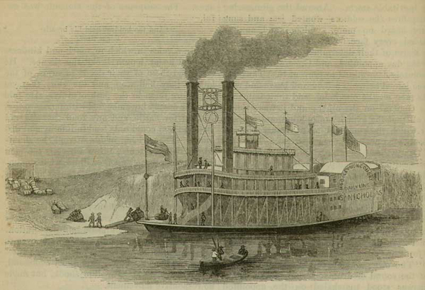
A different way to travel
In 1818, the first steamboat arrived in Detroit.
This was a huge improvement over boats that just had sails.
Steamboats began to take over travel routes on the Great Lakes.
What effect did steamboats have on travel?
Quicker
More reliable

Slide 8
People still weren’t convinced
Steamboats helped make it easier to get to Michigan, but people were still skeptical after the survey and Michigan having suitable farmland
Governor Cass decided to do something about it! What do you think he did?
In 1820, he decided to create his own survey and found that there was plenty of good farmland.
What effect did this have on people in the east?

Slide 9
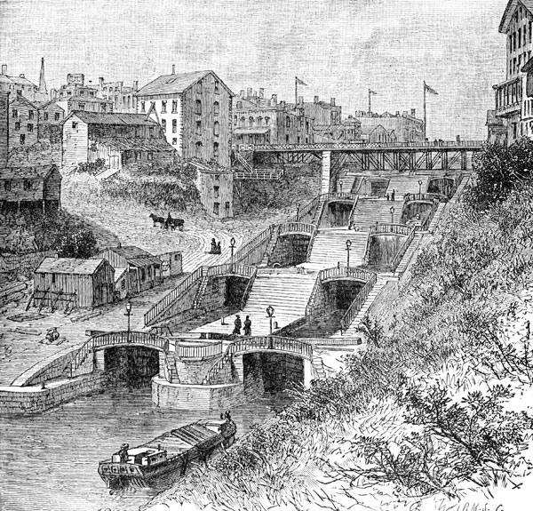
The erie canal
In 1825, the Erie Canal was opened.
The canal connected Lake Erie to the Hudson River in New York.
https://www.youtube.com/watch?v=oMz7eCj732w
How would this help people coming from the east to travel to Michigan?

Slide 10
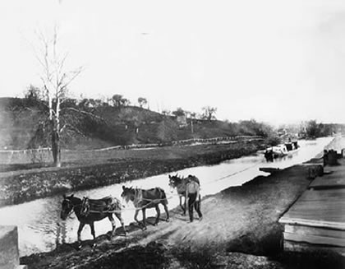
Fun facts
The Erie Canal
It was 363 miles long.
Flat boats were pulled along the canal by horses or mules.
The Erie Canal made it much easier and quicker for passengers to get to Michigan.
The opening of the Erie Canal led to a large increase in population of the Michigan Territory.

Slide 11
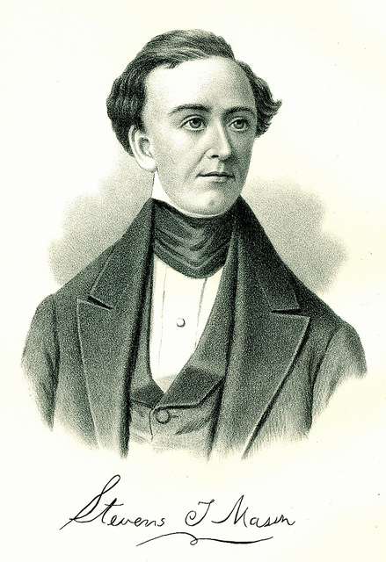
A new leader
In 1831, a new governor was appointed to Michigan – Stevens T. Mason
In 1834, Governor Mason ordered a consensus, or a counting of people in the area
He found that about 85,000 people lived in Michigan – well over the 60,000 people needed to become a state!

Slide 12
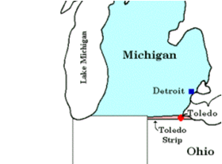
Another problem: The Toledo strip
The Toledo Strip: a small piece of land near the mouth of the Maumee River (which is now Toledo, Ohio)
Both Michigan and Ohio claimed the land.
The area was seen as valuable because it could be connected by rivers and canals to the Ohio River, which flowed to the Mississippi River.
The U.S. Congress said Michigan could not be a state until the disagreement over the Toledo Strip was resolved.
This became known as the “Toledo War.”

Slide 13
What did Michigan need to become a state?
Enough people to become a state – 60,000!
To fix the Toledo Strip problem
A constitution – a written plan for government to make laws and choose leaders for the state
In 1835, the state adopted a constitution and elected Stevens T. Mason as governor

Slide 14
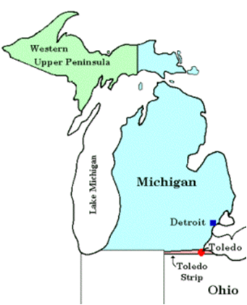
Resolving the Toledo strip problem
How could Ohio and Michigan think win-win or compromise in a non-violent way?
The U.S. federal government tried to help!
Ohio could get the Toledo Strip
Michigan would get the western part of the Upper Peninsula that was never a part of the Michigan Territory
How do you think Michigan and Ohio felt about that?

Slide 15
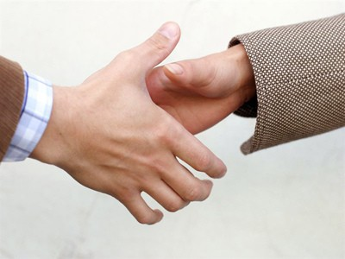
Michigan agrees….
In 1836, Ohio and Michigan reach an agreement and the Toledo Strip problem was finally solved.

Slide 16
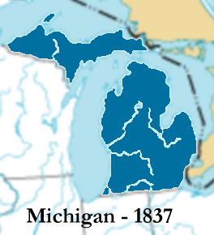
Michigan becomes a state!
1837

