Slide 1
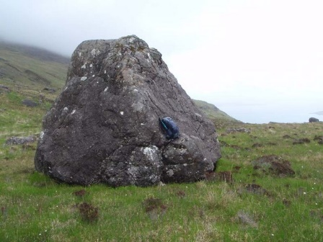
boulder
a large mass of rock

Slide 2
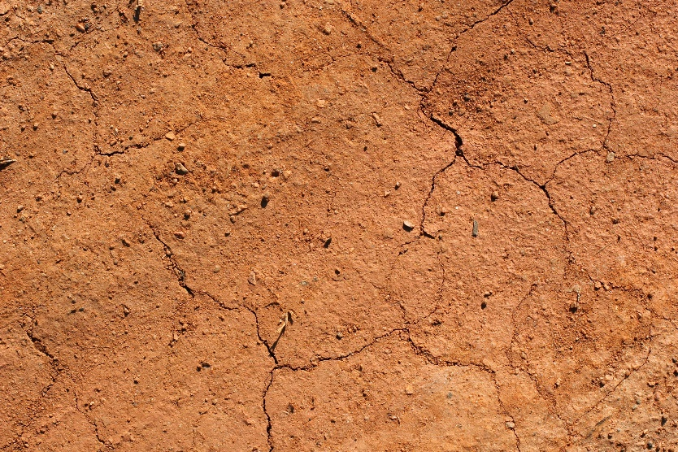
clay
an earth material with particles smaller than silt

Slide 3
earth materials
solid, natural materials that come from the Earth
Ex: minerals, rocks, sand, silt, clay, soil

Slide 4
earthquake
a violent shaking or vibration of the ground due to movement of sections of rock in the Earth which causes a rapid change to the Earth’s surface features, buildings, and roads.

Slide 5
erosion
when wind and/or water carries weathered particles from one place to another

Slide 6
glacier
a large body of ice and snow that moves down a slope or over a wide area of land causing slow changes to the Earth’s surface

Slide 7
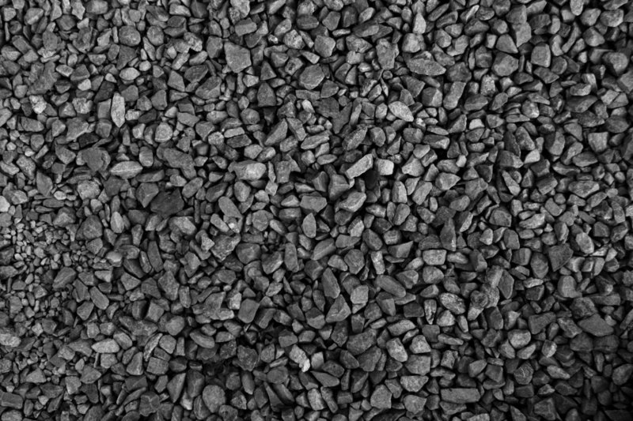
gravel
an earth material with small pieces of rock and stone that are larger than a grain of sand

Slide 8
landslide
the rapid movement of large areas of earth materials on a hill or mountain that slide to a lower level

Slide 9
metals
natural resources that have a more or less shiny appearance and are good conductors of heat and electricity
Ex: gold, bronze, tin, copper

Slide 10
mineral
an earth material that makes up rocks

Slide 11
mixture
a combination of two or more materials that keep their own properties and can be separated from one another

Slide 12
natural environment
any environment that occurs in nature and is not manufactured

Slide 13
natural resource
any material from the Earth that humans use to make things or produce energy

Slide 14
non-renewable resource
an earth material or natural product that cannot be regrown or made again

Slide 15
renewable resource
an earth material or natural product that can be regrown or made again

Slide 16
The Three R’s
Reduce
Reuse
Recycle

Slide 17
rock
a natural, solid earth material that is made of one or more different minerals

Slide 18
runoff
Water that does not soak into the ground, but flows downhill and carries earth materials from one place to another

Slide 19
sand
an earth material produced by the natural breaking up of certain types of rocks

Slide 20
silt
an earth material with particles smaller than sand

Slide 21
soil
an earth material that is a mixture of sand, silt, clay, and once living plant and animal materials

Slide 22
volcano
an opening in the Earth through which molten rock and other materials reach the surface causing rapid changes to the surface of the Earth producing hills, mountains, or landslides

Slide 23
weathering
the wearing away of rock and soil due to sun, wind, ice, rain, and moving water

