Slide 1
French Explorers
Lesson 4
Unit 3 Social Studies – Michigan History

Slide 2
French Explorers
Europeans loved goods imported from China like silk and spices
But….goods became scarce.
So….explorers decided to travel to China to get more.

Slide 3
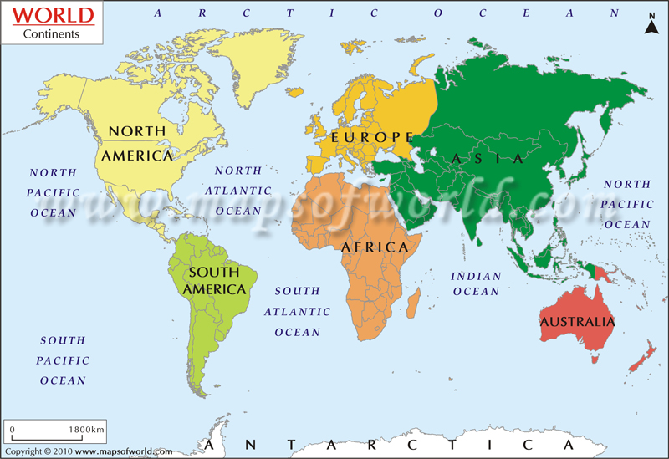
How Did They Get There?

Slide 4
French Explorers
First explorer to try and sail across the ocean
Found a continent was in his way
Got as far as the Great Lakes and discovered a valuable item....

Slide 5
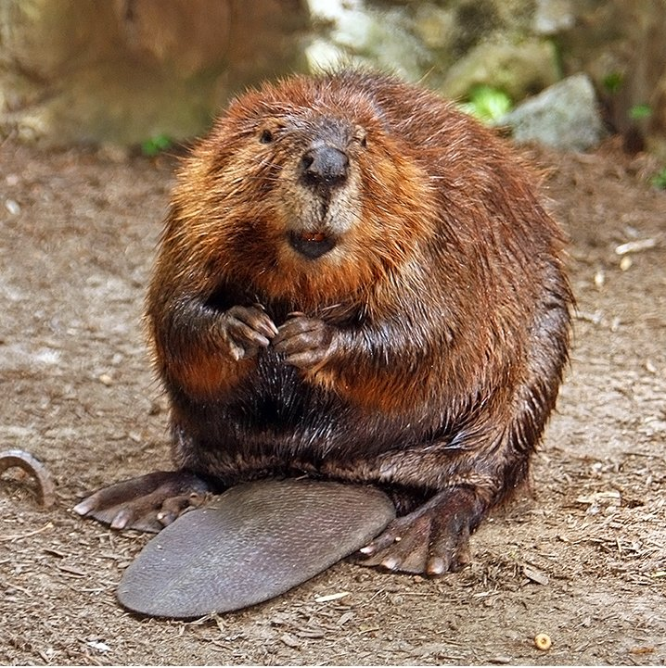
Beavers
Teeth used to cut down small trees
Used for fur-bearing qualities
  Fur was used to make:
    Clothing
    Fur hats

