Slide 1
Michigan’s Human Characteristics
Lesson 5 – SS
I can describe human characteristics in Michigan.

Slide 2
Let’s Review
On a notecard, pick 2 topics and share 1 fact for each topic. Please write neatly.
Landforms
Bodies of Water
Vegetation
Climate

Slide 3
Example
Landforms:
  Michigan has two peninsulas: the Upper Peninsula and Lower Peninsula.
  Climate:
    The Great Lakes affect Michigan’s temperature and precipitation.

Slide 4
Review Game
In just a few minutes, you will be getting up and walking around.
When the music stops, you will find a partner and share what’s on your notecard.
When the music starts up again, you’ll say “Thank you” to your partner and switch notecards and begin walking around.
You’ll now be sharing the new notecard that you have.

Slide 5
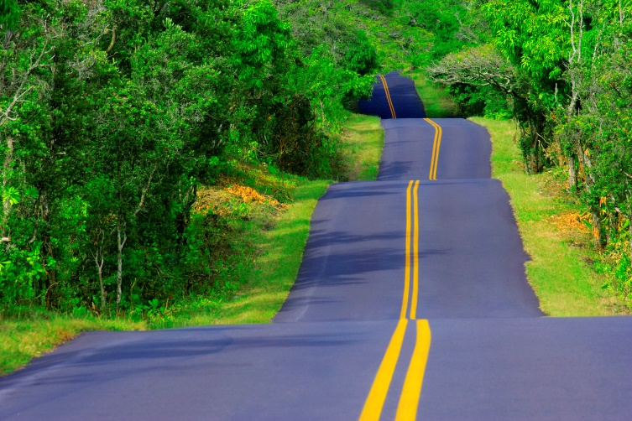
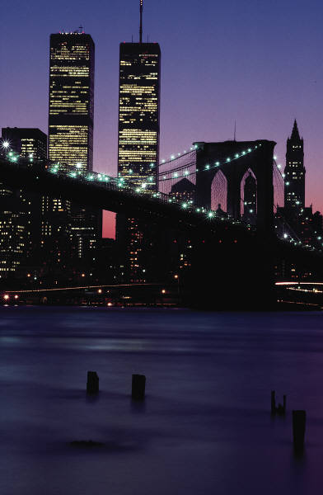
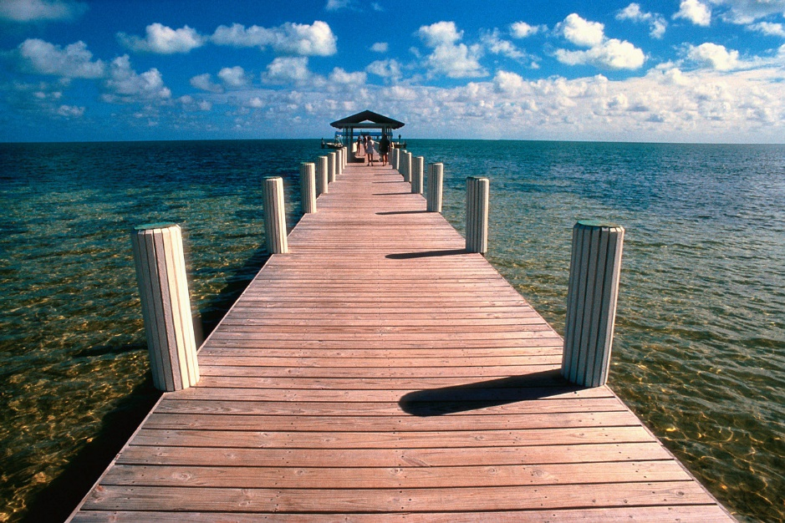

Human Characteristics
Human characteristics are things built/made by humans.

Slide 6
Why Do We Need Human Characteristics?
Islands
Rivers
Lakes
Forests
Peninsulas

Slide 7
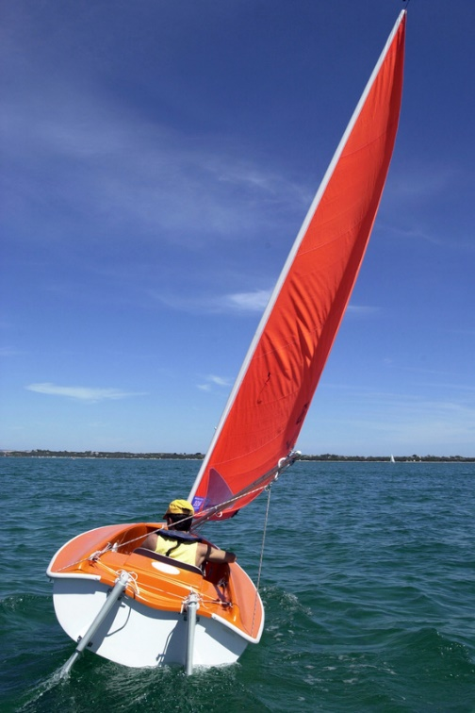

Crossing Water

Slide 8
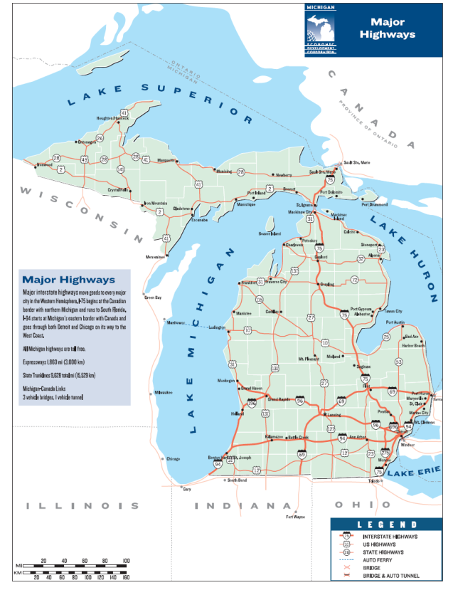
Michigan Highways
•Most highways go either north/south or east/west.
•A lot of highways go to the Detroit area.
•There are fewer highways in the Upper Peninsula.
•In the Lower Peninsula highways go almost all the way round the coastlines.

Slide 9
Can You Locate On the Map?
• St. Ignace and Mackinaw City, the two cities on either side of the Mackinac Bridge
• Detroit, the largest city in Michigan
• Marquette, the largest city in the Upper Peninsula
• Lansing, the state capital
• Grand Rapids, another large city
• Sault Ste. Marie, an important city in the Upper Peninsula
• Ludington, a city where you can take a ferry across Lake Michigan to the state of Wisconsin

Slide 10
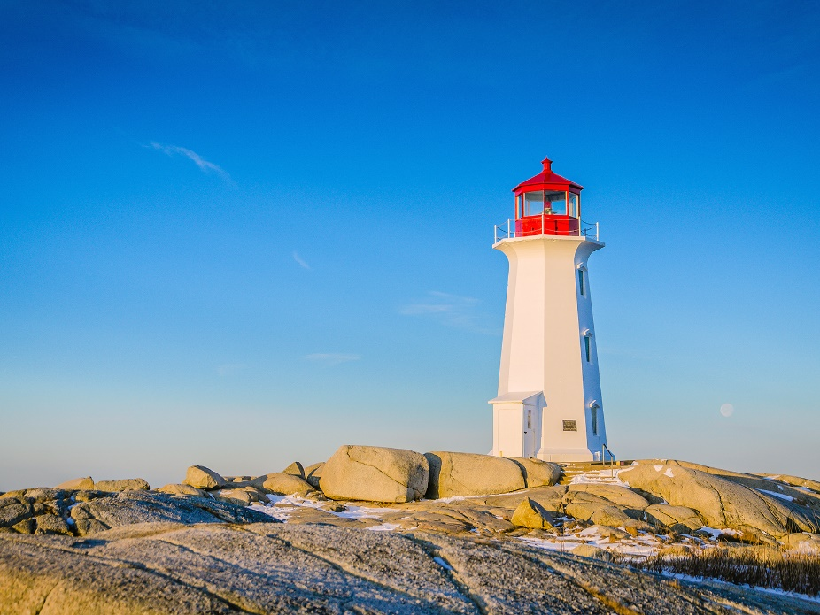
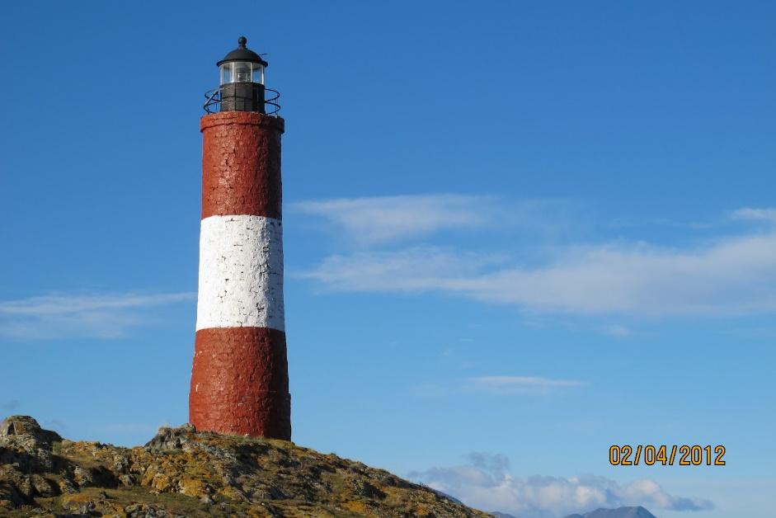
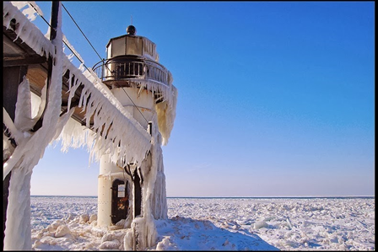
One of Michigan’s Most Unique Human Characteristics

Slide 11
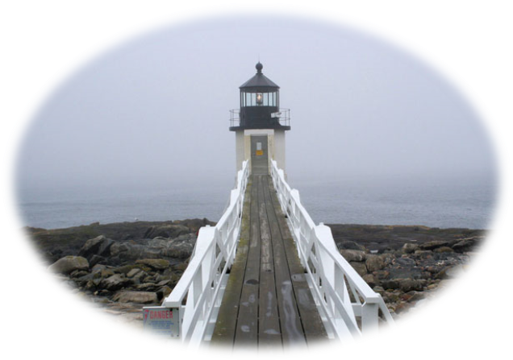
Michigan’s Lighthouses
• In some places there are a lot of lighthouses clustered together.
• Near the Mackinac Bridge there are a lot of lighthouses.
• Lighthouses are sometimes on islands.
• Lighthouses are often at the end of points, or peninsulas.
• Lighthouses are often at the end of a bay.

Slide 12
Let’s Recap!

