Slide 1
Migration and Settlement in Michigan
Unit 3 – The Early History of Michigan – Lesson 6
I can identify challenges that faced early pioneers in Michigan and explain the cause-effect relationship of its slowly growing population.

Slide 2
Materials Needed for Lesson
Cause/Effect Graphic Organizer Sheet (blank)
Pioneer Graphic Organizer Sheet (blank boxes)
Mentor Text: The Log Cabin Quilt or The Log Cabin Christmas
Artifact Cards (optional) for group activity
Glue these into your Social Studies folder prior to the slideshow!

Slide 3
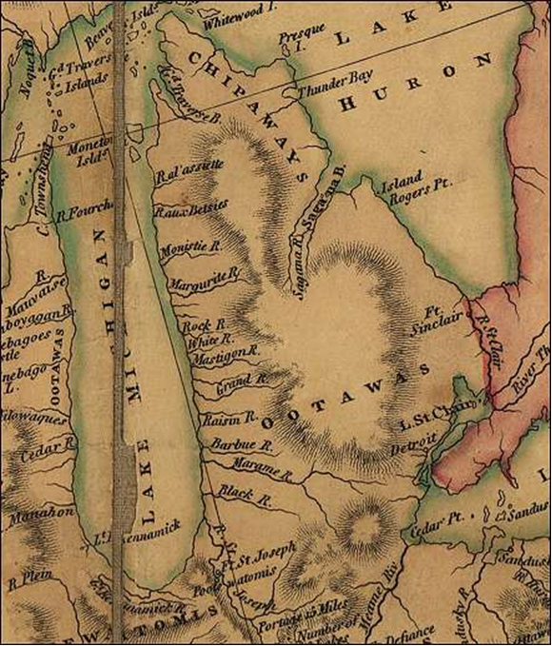
What do you think this is? Turn and talk about it.
This is a map of Michigan from about 200 years ago!
Would this be a primary or secondary source? Why?

Slide 4
Two Main Settlements in Michigan
Detroit
Mackinaw Island
Pioneers – people who came to a new area to settle (live)
Why did pioneers come to Michigan?

Slide 5
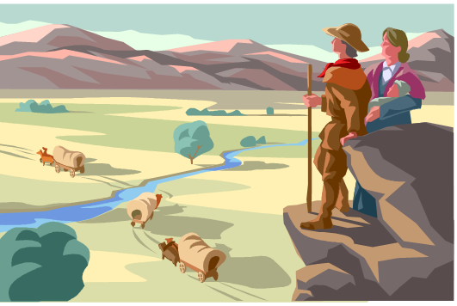
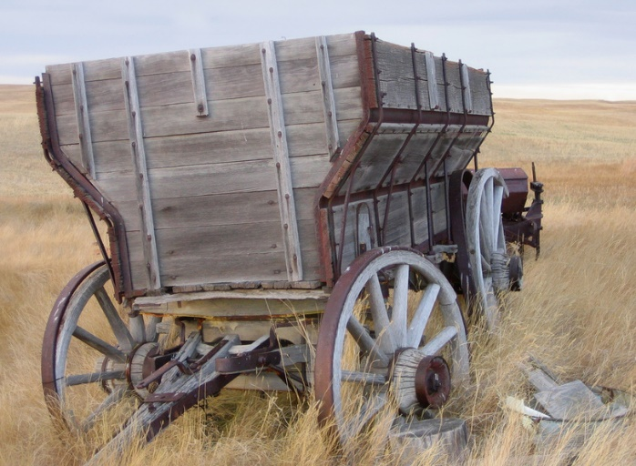
Imagine….
Imagine life as a pioneer. What it would be like to move to a brand new place with….
  Very few roads
  Very few maps to describe it
  Covered in forests
  What challenges would you face?
  Turn and talk and then share out ideas.

Slide 6
New Challenges
Getting lost – not many ways to navigate around
Travel conditions – getting across water, wagons traveling on bumpy terrain with very few roads
Cutting down trees to build a cabin
Clearing the land for farming
Trying to grow a crop like wheat
Wild animals and mosquitoes
Weather conditions like thunderstorms, snowstorms

Slide 7
A Very Slow Start For Michigan
Few people came to settle in Michigan in the early 1800s.
What caused this to happen?
What effects did this have on Michigan?

Slide 8
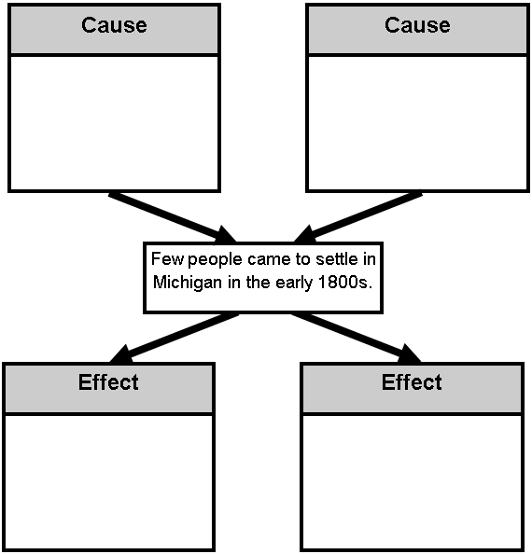
It was hard to travel to Michigan.
People didn’t think
Michigan had
good farmland.
Jot your notes down in your
graphic organizer in your Social Studies folder!
Few towns were started.
The population of
people grew very
slowly.

