Slide 1
The British
Lesson 5
Social Studies – Unit 3
Michigan History

Slide 2

The competition….
The French weren’t the only ones trying to explore and claim land from Europe…..
Here come the British!

Slide 3
Show Timeline of French forts
Why do you think the French built all of these forts in such a short period of time?

Slide 4


The problem
The French
The British

Slide 5
What did they want?
French Mission
British Mission
Wanted to trade with Native Americans
Respected their land
Respected their people
Disliked British people
Wanted to take over fur trade and Michigan
Wanted to take over French forts
Wanted Native American land
Didn’t care about Native Americans

Slide 6
Cause and effect
Cause?
What caused the war?
War between France and Britain
Effect?
What effect did this have?

Slide 7


What did the Indians do?
STAY OUT OF THE WAR?
HELP THE FRENCH OR BRITISH?

Slide 8
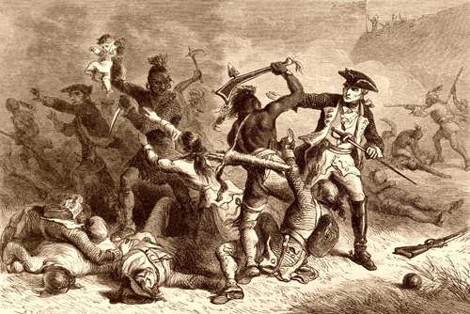
Indians chose the French!
Trading partners for years
Didn’t want to take their land, just wanted to trade
French respected them
The French married American Indian women
French gave them lots of gifts

Slide 9

So, Who won?

Slide 10
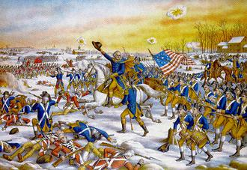
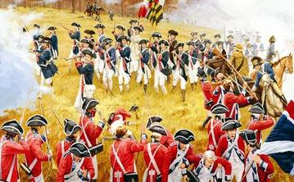
British control
Took over fur trade and Michigan in 1760
Took over French forts
Raised prices on European goods, so it took more furs to trade for an item – mad at Indians for not being allies

Slide 11
Another Conflict
American Indians vs. British

Slide 12
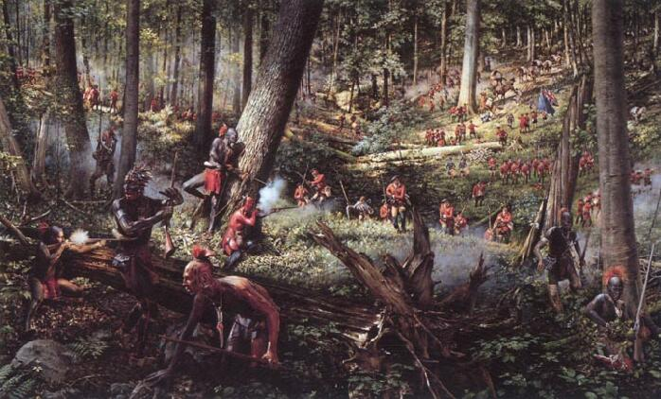
Indians vs. British
Chief Pontiac led an alliance of many tribes
American Indians began to attack British forts
Captured St. Joseph and Fort Millimackinac
Tried to force British out of Detroit fort, but failed and British ended regaining control

Slide 13

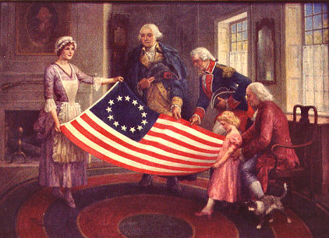
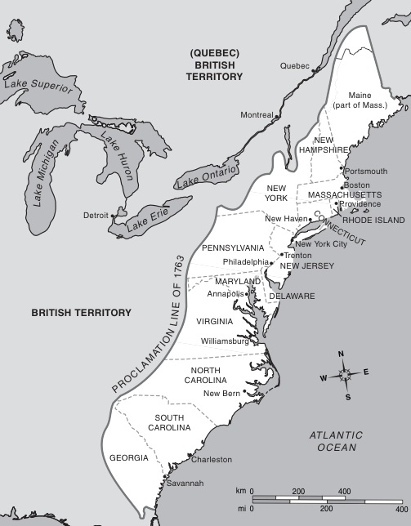
13 Colonies
Owned by British
Colonies wanted to be independent (own country)
Declared independence on July 4th, 1776
Won war against Britain and became United States of America (1st 13 states)

