Slide 1
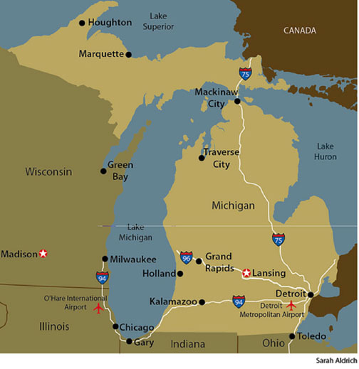
The Growth of Michigan
I can analyze how Michigan’s location and natural resources influenced its economic development.

Slide 2
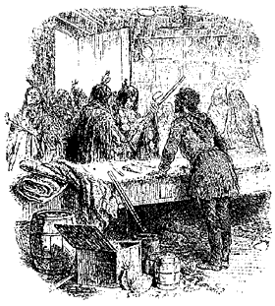
Let’s Go Back to the Early Days….
Economy: The study of how people use resources to produce goods and services.
Think back to Michigan’s history -
How did the French and Indians use natural resources to produce new goods and services?

Slide 3
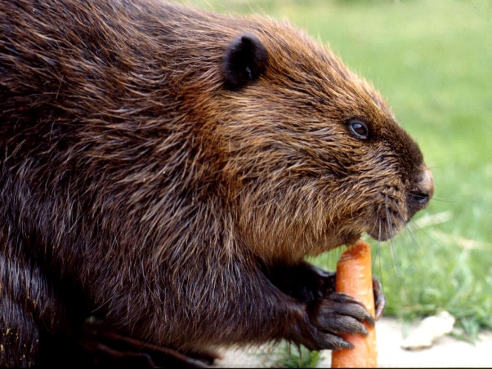
The End of The Fur Trade
By the time Michigan became a state, the fur trade had ended.
Why might the fur trade have ended?
What resources became scarce?

Slide 4
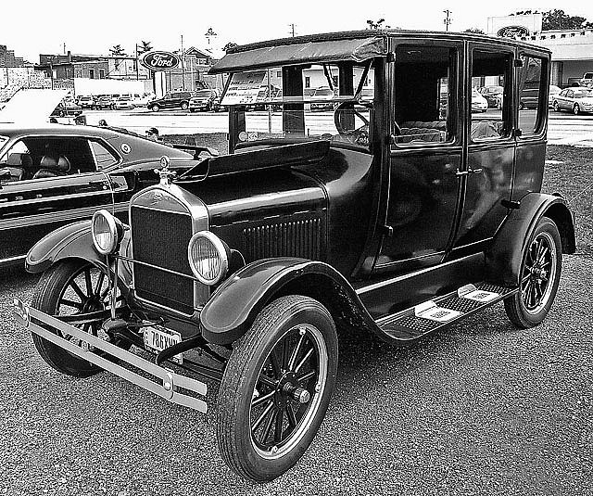
The Growth of Michigan
People’s needs and wants change over time.
Goods and services change over time. (Think about Henry Ford and the Model T!)
How did Michigan change over time?

Slide 5
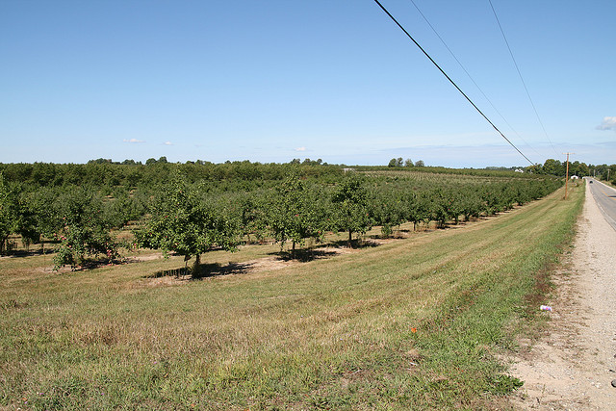
What economic activity took over?
Farming!
How would Michigan’s land be popular for farming? Describe the lower peninsula and what it had to offer people.

Slide 6
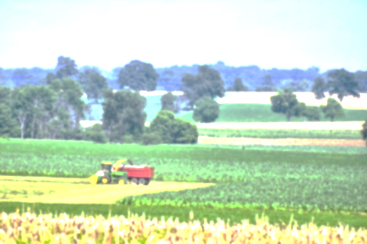
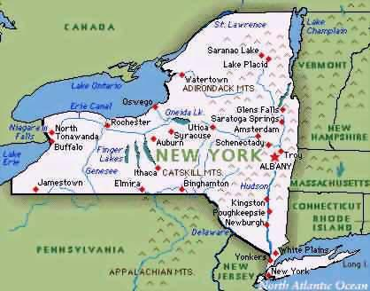
Why Move to Michigan?
Cheap farmland
Lots of it!
Several people living in New York moved to Michigan due to the lack of good farmland.

Slide 7
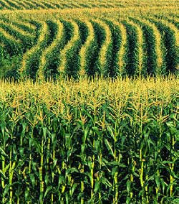
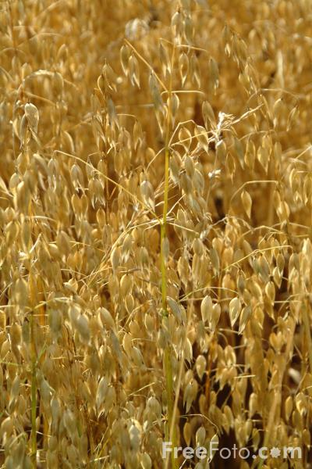
What did Michigan Farmers Grow?
Oats
Wheat
Corn

Slide 8
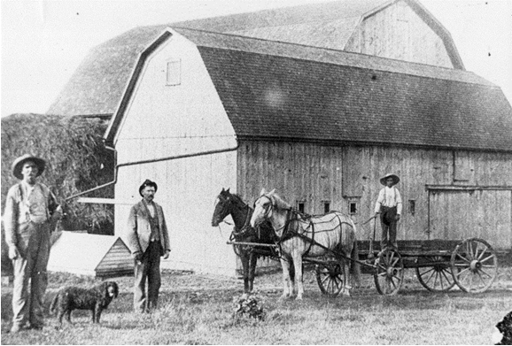
Farming near Stockbridge, Michigan
Are these photographs a primary or secondary
source? Why?
What can you infer about farming in the early days of Michigan?

Slide 9
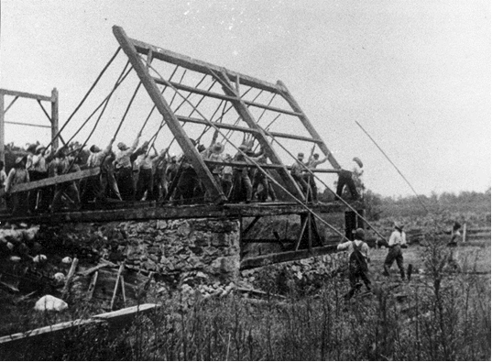
Farming near Stockbridge, Michigan

Slide 10
Artifacts found on farms
Can you guess
what these tools are and what they were used for?

Slide 11
Where did farmers get all of these tools?

Slide 12
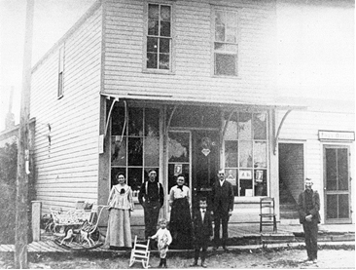
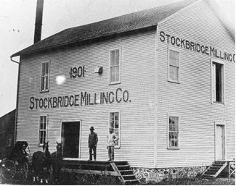
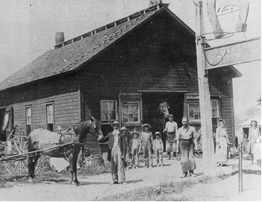
Important Businesses for Farmers
General Store
Mill
Why were these places important for farmers?
Blacksmith Shop

Slide 13
A Farming Memoir
Let’s read about what it was like growing up on a farm in the 1890’s.
Partner Read

Slide 14
Changing (Modifying) Michigan’s Environment
Please answer in your notebook:
How was Michigan’s environment changed because of farming?

