Slide 1
geography
the study of places
Ex: communities, states, countries

Slide 2
geographer
someone who studies places

Slide 3
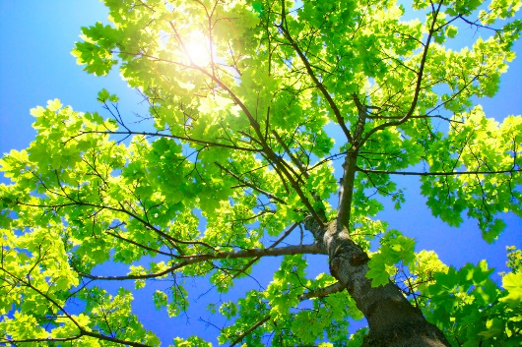
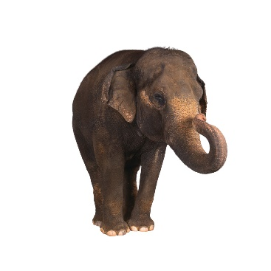
natural resources
things that were not made by humans

Slide 4
human characteristics
parts of a place made by people
Ex: bridges, roads, buildings

Slide 5
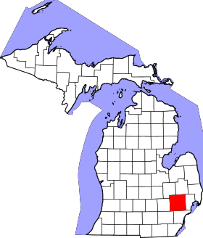
county
a division of a state
Ex: Michigan is divided into 83 counties.

Slide 6
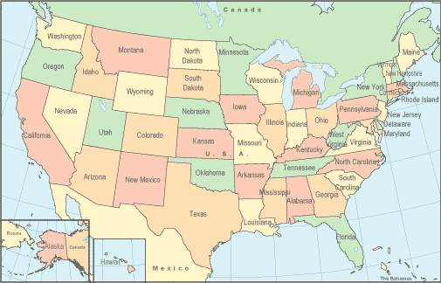
state
one of the 50 parts of our country

Slide 7
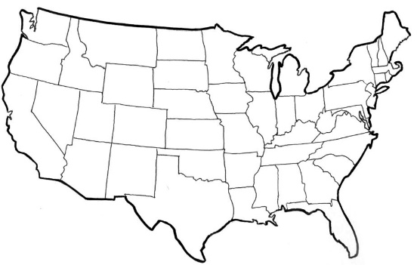
border
the place where one area ends and another begins
Ex: You can see the borders of states on a United States map.

Slide 8
government
a group of selected citizens who make and carry out the rules for a community, state, or country.

Slide 9
location
where a place is found

Slide 10
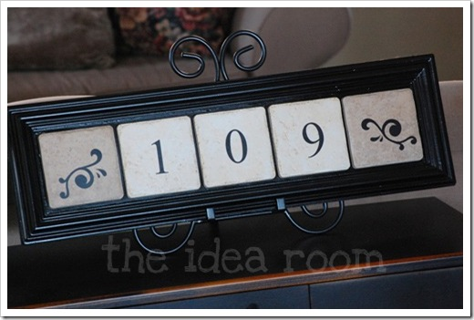
absolute location
where the exact location of a place is
Ex: Your address

Slide 11
relative location
where a place is in relation to other places
Ex: The relative location of Michigan is in the northern part of the United States.

Slide 12
map
a picture that shows the location of something

Slide 13
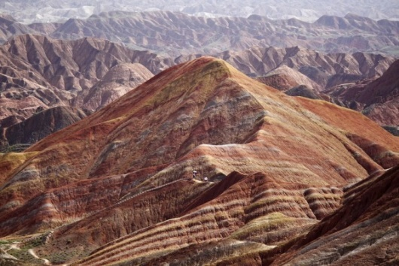
landforms
different kinds of land on the Earth
Ex: hills, mountains, plateaus, valleys, islands

Slide 14
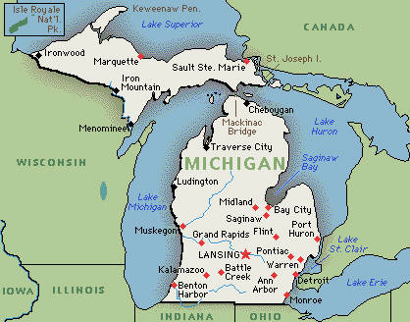
peninsula
land surrounded by water on three sides
Ex: Michigan is made up of two peninsulas.

Slide 15
island
a piece of land surrounded by water on all sides
Ex: Beaver Island and Mackinaw Island are important islands in Michigan.

Slide 16
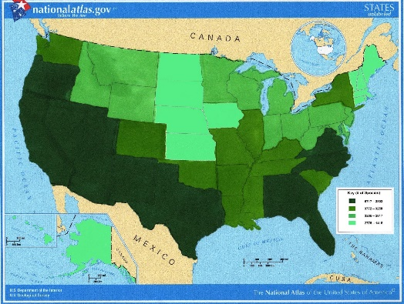
special purpose maps
maps that show characteristics of an area such as landforms, climate, or forests

Slide 17
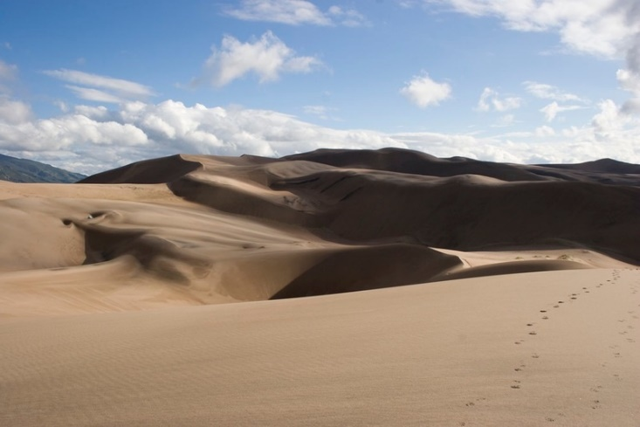
sand dunes
ridges or hills of loose sand piled up by the wind

Slide 18
Great Lakes
H.O.M.E.S
Huron, Ontario, Michigan, Erie, Superior

Slide 19
bay
a body of water partly blocked off by land

Slide 20
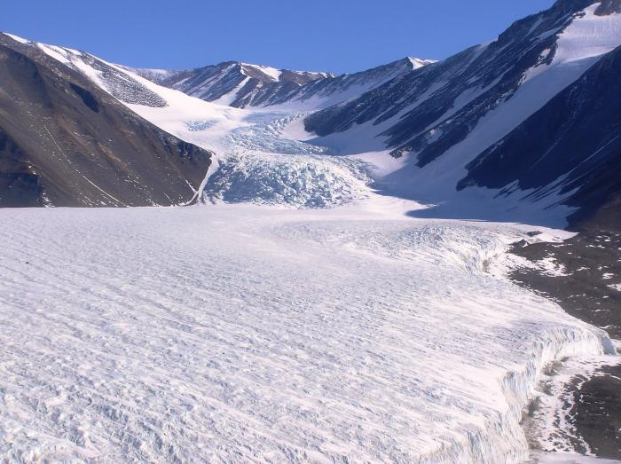
glacier
giant sheets of slowly moving ice

Slide 21
vegetation
the plants of an area
Ex: white pines, wildflowers, apple trees, bushes

Slide 22
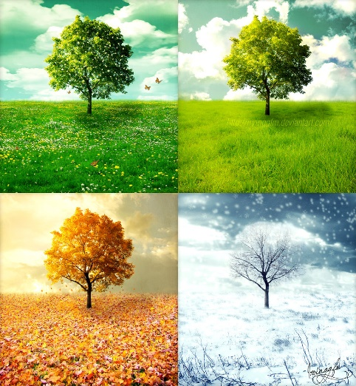
climate
weather over a long period of time
Ex: Michigan’s climate has four seasons.

Slide 23
precipitation
rain that falls to the ground as hail, sleet, snow, or rain

Slide 24
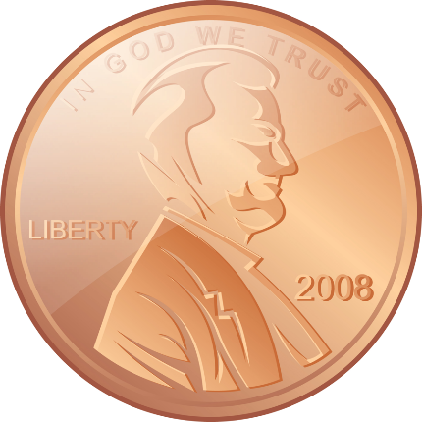
minerals
natural resources found in the ground
Ex: copper, iron ore

Slide 25

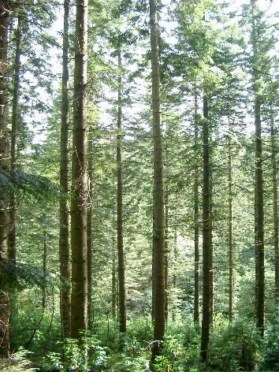
renewable resources
natural resources that can be replaced or regrown

Slide 26

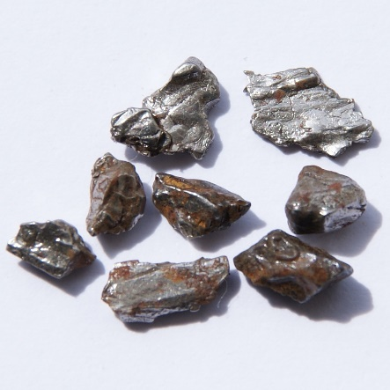
non-renewable resources
natural resources that cannot be replaced or regrown

Slide 27
movement
the theme of geography that describes how and why people, ideas, and goods move

Slide 28
transportation
ways of moving things and people from one place to another

Slide 29
hub
a city where many railroads and roads meet
Ex: Detroit is a transportation hub in Michigan.

Slide 30
port
a city on a body of water where ships load and unload.
Ex: Detroit is an important Michigan port.

Slide 31
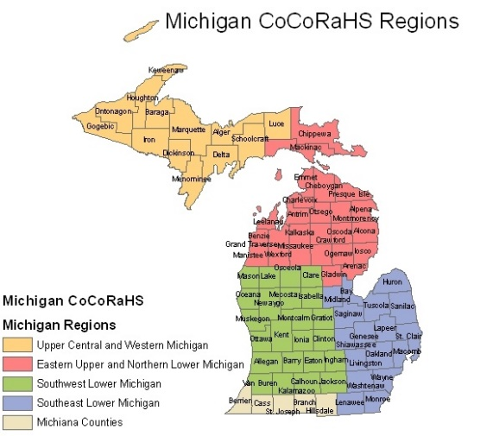
region
an area with one or more common features
Ex: Great Lakes Region
Midwest Region

Slide 32
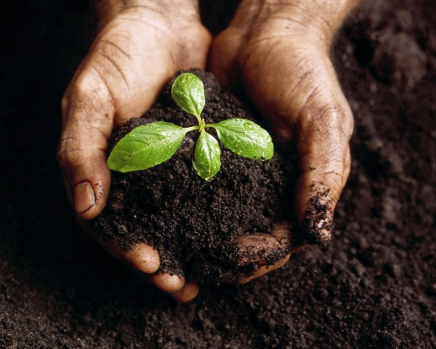
fertile soil
soil that is good for growing things and for farming

Slide 33

North

Slide 34
South

Slide 35
East

Slide 36
West

