Slide 1
economics
the study of how people use limited resources to produce goods and services that people want or need

Slide 2
economy
activities related to making, trading, and selling goods and services
Ex: Making cars

Slide 3


natural resources
things that were not made by humans

Slide 4

capital resources
goods that are produced to make more goods and services
Ex: factories, tools

Slide 5
human resources
workers and their skills

Slide 6
entrepreneur
someone who combines natural, human, and capital resources to produce goods and services
Ex: Henry Ford invented the car.

Slide 7
scarcity
not enough of something so people have to make choices

Slide 8
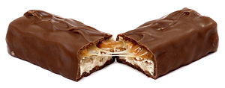
opportunity cost
When you make a choice, your opportunity cost is your second choice, or the thing you wanted next.
Ex: Amy went to the store to buy Skittles but they were out. She bought a Snickers bar instead. The Snickers bar was her opportunity cost (her second choice).

Slide 9
incentive
something used to get people to buy or produce a certain good or service
Ex: a sale or discount

Slide 10
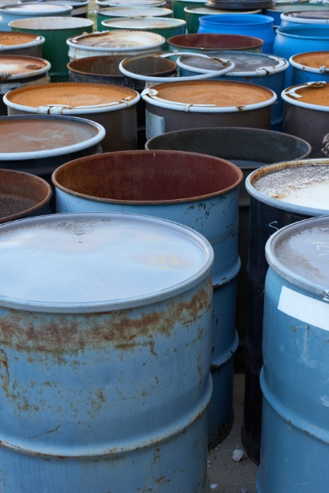
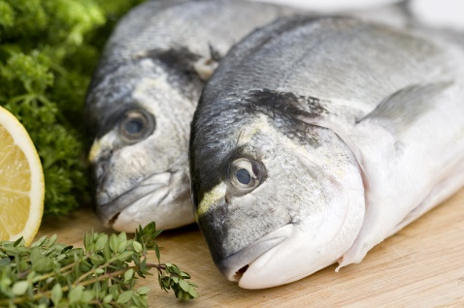
limited resources
There are only a certain amount of resources.

Slide 11
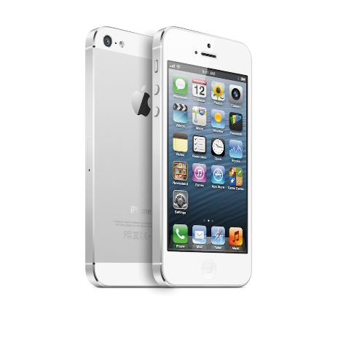

unlimited wants
There is no end to the amount of things people want or need.

Slide 12


specialization
when individuals, regions, and countries produce certain kinds of goods or services

Slide 13
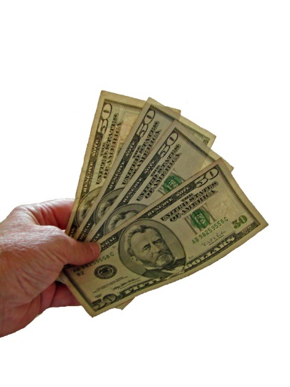

trade
to exchange one thing for another

Slide 14
interdependence
when people are dependent on other people in order to get the things they do not produce

Slide 15
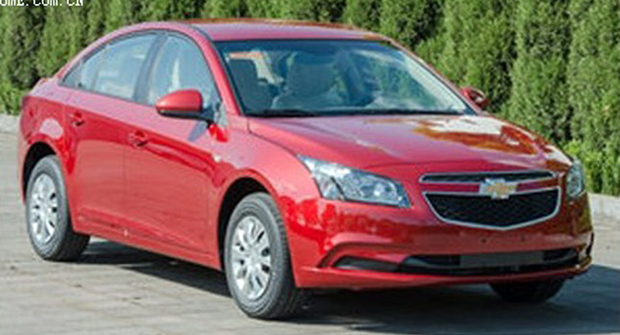
export
a good that people in one place send out to people in another place when they trade

Slide 16

import
a good that people in one place bring in from another place when they trade

Slide 17
wind turbine
a tall tower with blades that make use of wind to create electricity

Slide 18
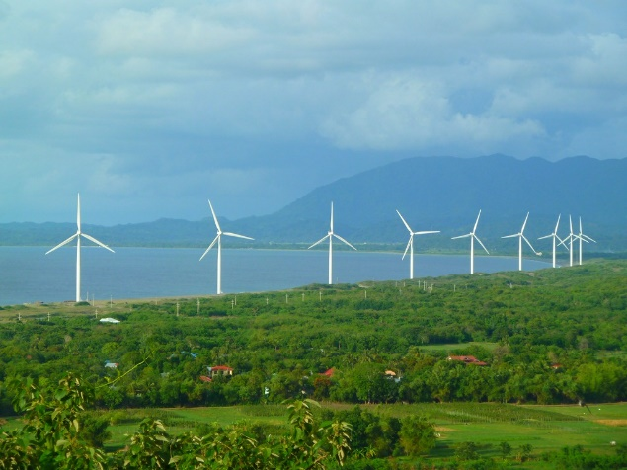
wind farms
a group of wind turbines in the same location

Slide 19
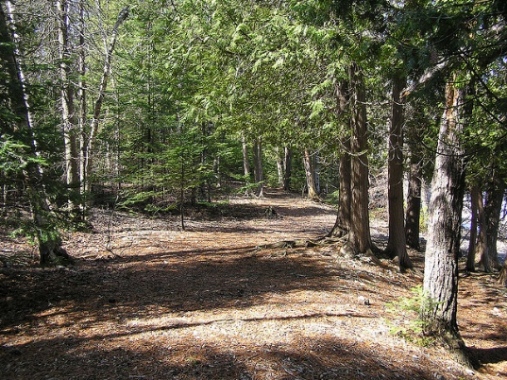
public goods and services
goods and services that are produced and serviced by a government
Ex: state parks

Slide 20

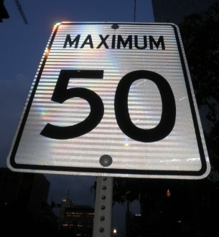
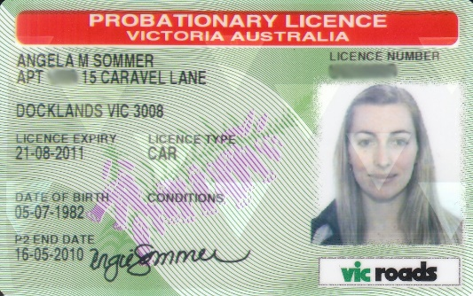
fees-money people pay to the government in exchange for being able to do a certain activity
Ex: paying a fee to use state park fines-money people pay to the government for breaking a rule or law
Ex: a speeding ticket license-a legal document giving you permission to do something

Slide 21
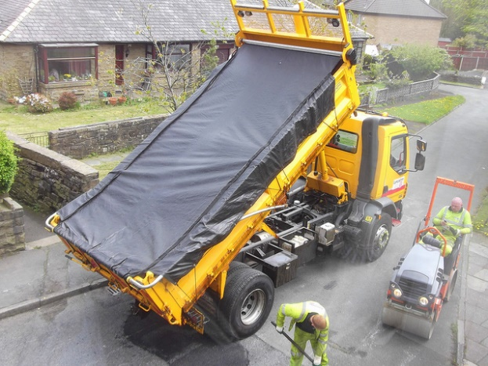
taxes
what people pay to the government in exchange for services like schools or road repair

