Slide 1
history
what happened in the past
A historian studies clues from the past.

Slide 2
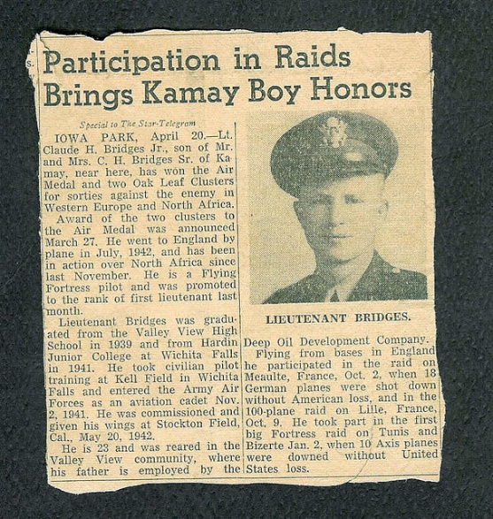
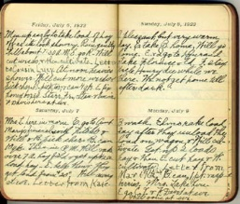

primary sources
records made by people who saw or took place in an event
Ex: newspaper articles, diaries, photgraphs

Slide 3

secondary sources
records written by someone who was not there at the time
Ex: textbooks

Slide 4
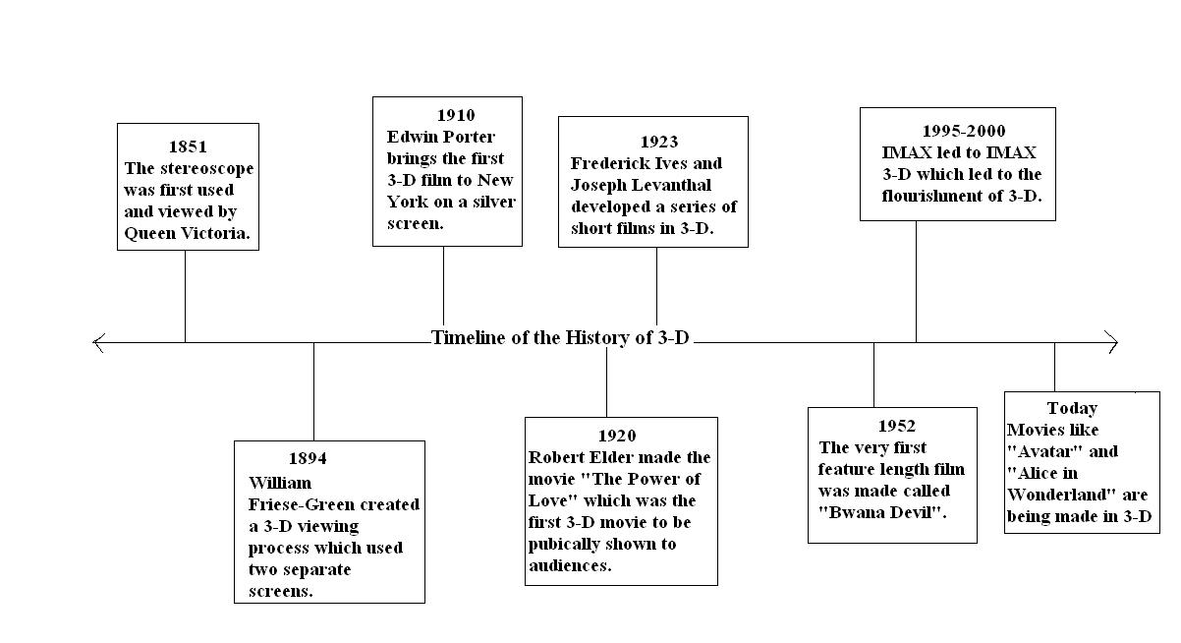
timeline
a diagram that shows the order in which events happened

Slide 5
decade
a ten year period of time
Ex: 2000, 2001, 2002, 2003, 2004, 2005, 2006, 2007, 2008, 2009 = 1 decade

Slide 6
cause-effect
A cause is an action that makes something happen.
An effect is something that results from something else happening.
Cause Event Effect

Slide 7
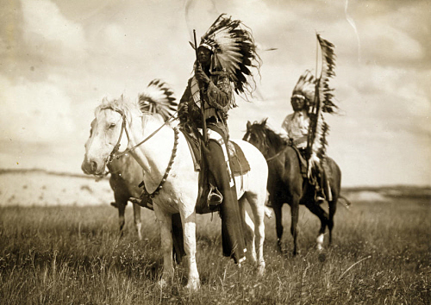
American Indians
the first people to live on the land which became the United States

Slide 8
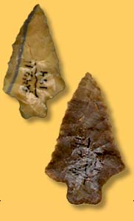
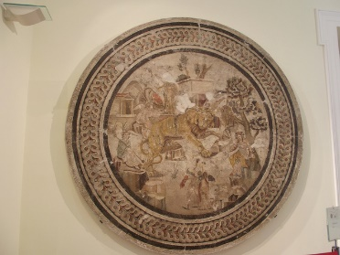
artifacts
things from the past that are left for us to study
Ex: old tools, dishes, buttons

Slide 9
alliance
when groups of people come together to help each other when there are problems

Slide 10
archaeologist
a special historian who study artifacts of the past

Slide 11
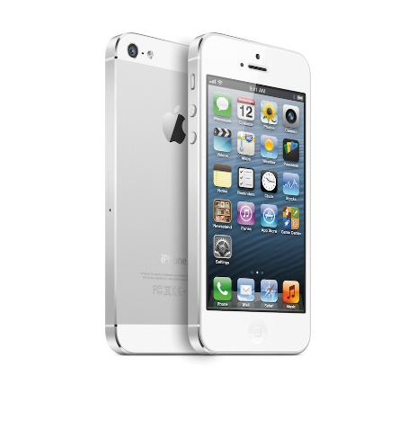

unlimited wants
There is no end to the amount of things people want or need.

Slide 12


specialization
when individuals, regions, and countries produce certain kinds of goods or services

Slide 13
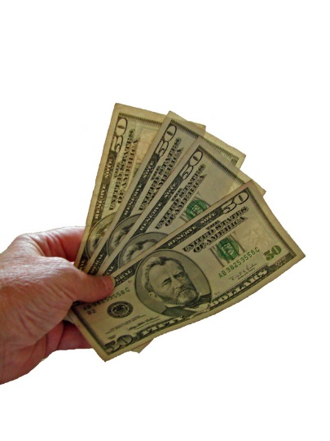

trade
to exchange one thing for another

Slide 14
interdependence
when people are dependent on other people in order to get the things they do not produce

Slide 15
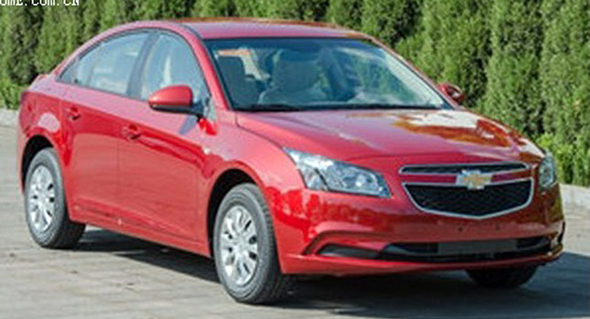
export
a good that people in one place send out to people in another place when they trade

Slide 16

import
a good that people in one place bring in from another place when they trade

Slide 17
wind turbine
a tall tower with blades that make use of wind to create electricity

Slide 18
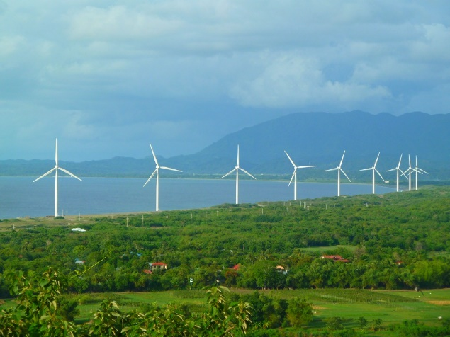
wind farms
a group of wind turbines in the same location

Slide 19
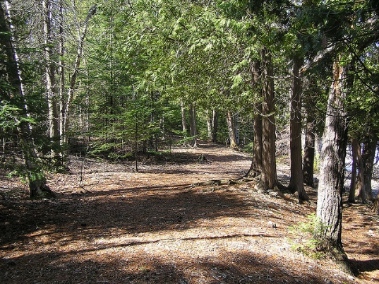
public goods and services
goods and services that are produced and serviced by a government
Ex: state parks

Slide 20

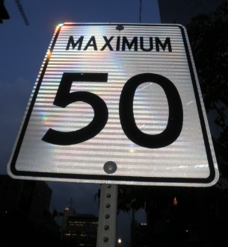
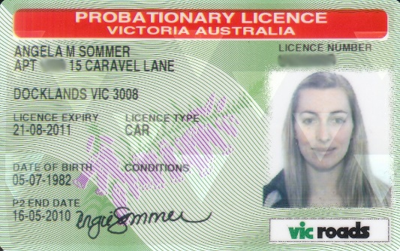
fees-money people pay to the government in exchange for being able to do a certain activity
Ex: paying a fee to use state park fines-money people pay to the government for breaking a rule or law
Ex: a speeding ticket license-a legal document giving you permission to do something

Slide 21
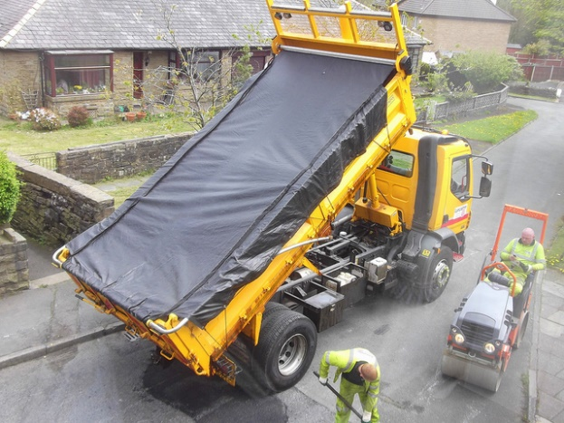
taxes
what people pay to the government in exchange for services like schools or road repair

