Slide 1
Vegetation and Climate
SS Lesson 4
I can use special purpose maps to identify natural (physical) characteristics in Michigan.

Slide 2
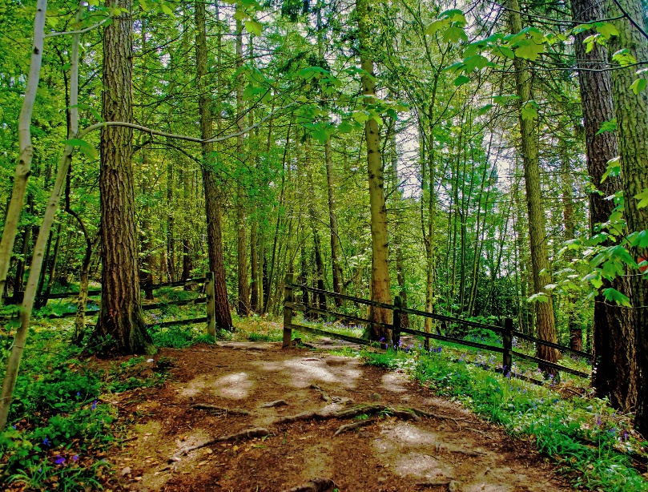
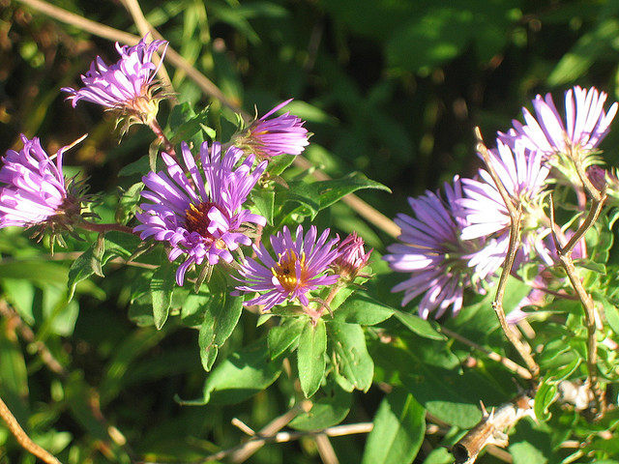
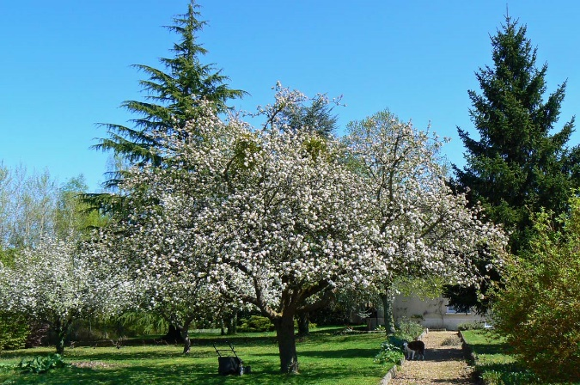
Michigan’s Vegetation
Vegetation means plants of an area.
Vegetation in Michigan:
forests (trees)
Apple blossom trees – orchards
wildflowers

Slide 3
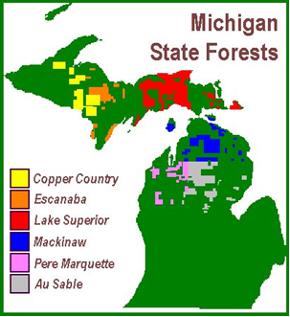
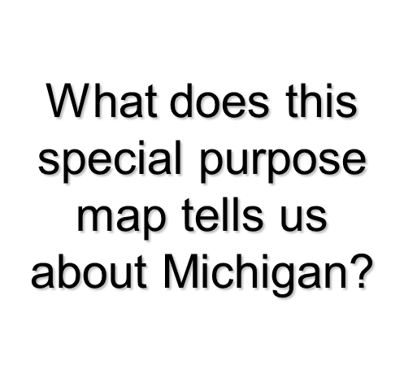
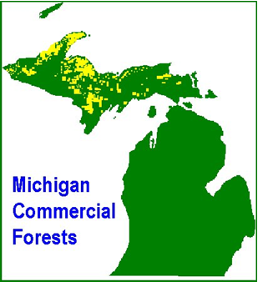
Special Purpose Maps
Maps that show characteristics of an area
Ex: Michigan’s vegetation (plants)

Slide 4
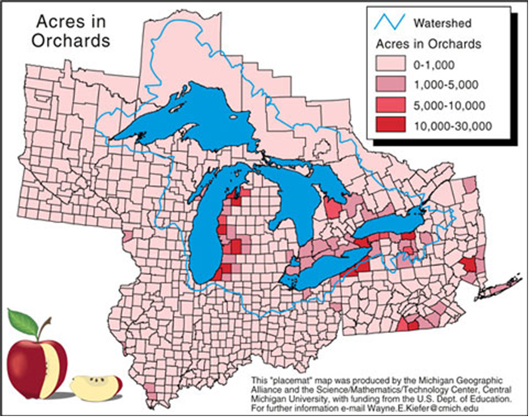

Michigan’s Orchards
How is the location of Michigan’s orchards different from forests?

Slide 5
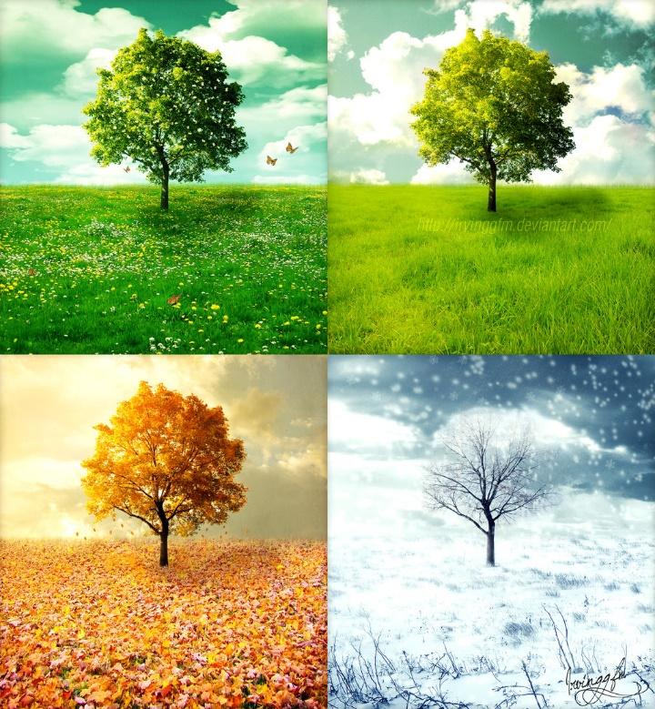
Michigan’s Climate
Climate is a period of weather over time.
What type of weather does Michigan have?
Winter: cold, snowy, icy
Spring: rainy, cloudy, cool
Summer: sunny, warm, humid
Fall: cool, windy

Slide 6
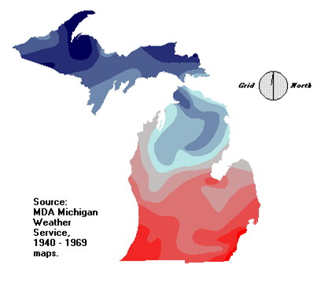
Michigan’s Average Temperature Map

Slide 7
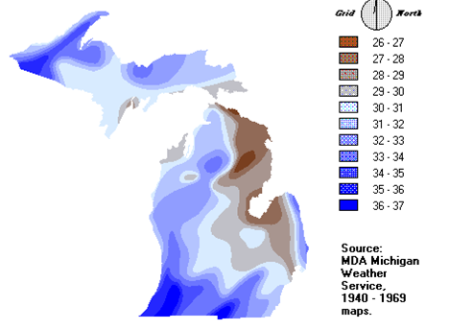
Michigan’s Precipitation (rainfall)

Slide 8
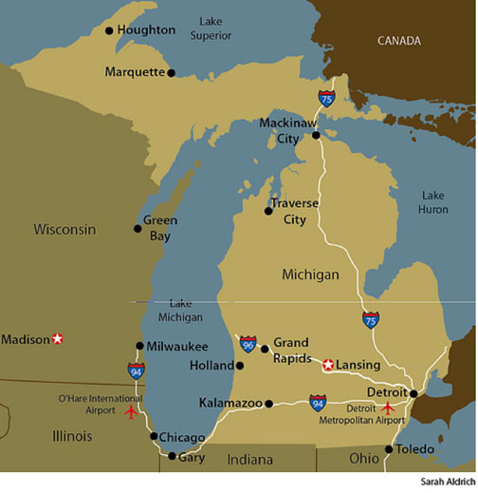
Michigan’s Climate and The Great Lakes
The Great Lakes affects Michigan’s climate – being near large bodies of water can affect an area’s temperature and precipitation!
“Lake Effect” – areas tend to get more precipitation (snow, rain, sleet) and are colder!

Slide 10
Michigan’s State Symbols
http://www.michigan.gov/documents/mhc_mhm_statesymbols2002_47909_7.pdf

