Slide 1

What is a Scientist?

Slide 2
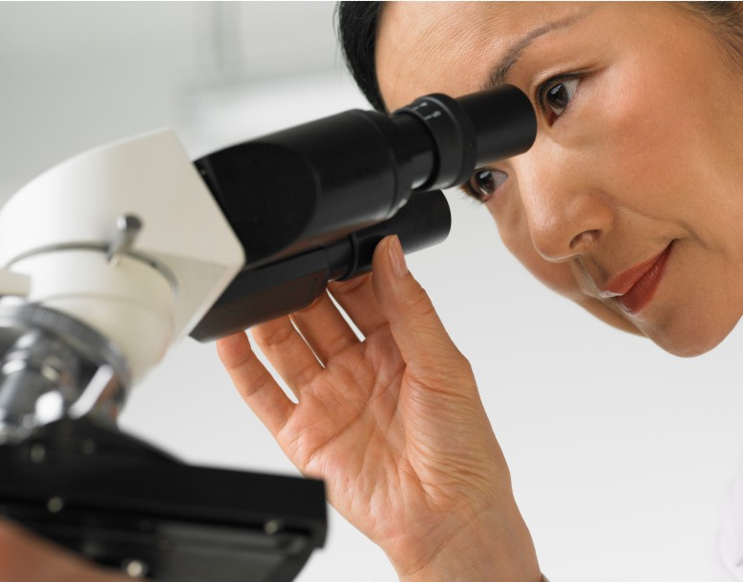
Scientists study the world around us.

Slide 3
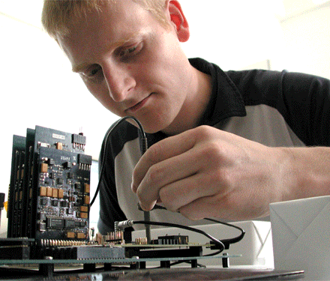
Some scientists study how things work and help make them work better. This scientist is an engineer.

Slide 4

Some scientists study the human body and help us stay healthy. This scientist is a doctor.

Slide 5
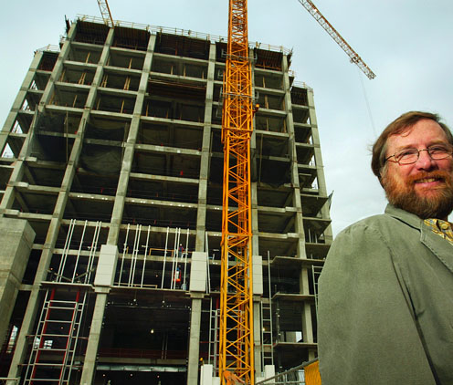
Some scientists help design new buildings. This scientist is an architect.

Slide 6
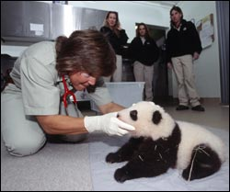
Some scientists study animals. This scientist is a zoologist.

Slide 7
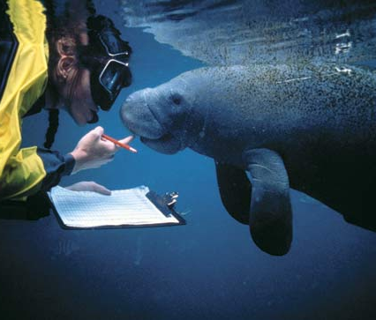
Some scientists study ocean animals. This scientist is a marine biologist.

Slide 8
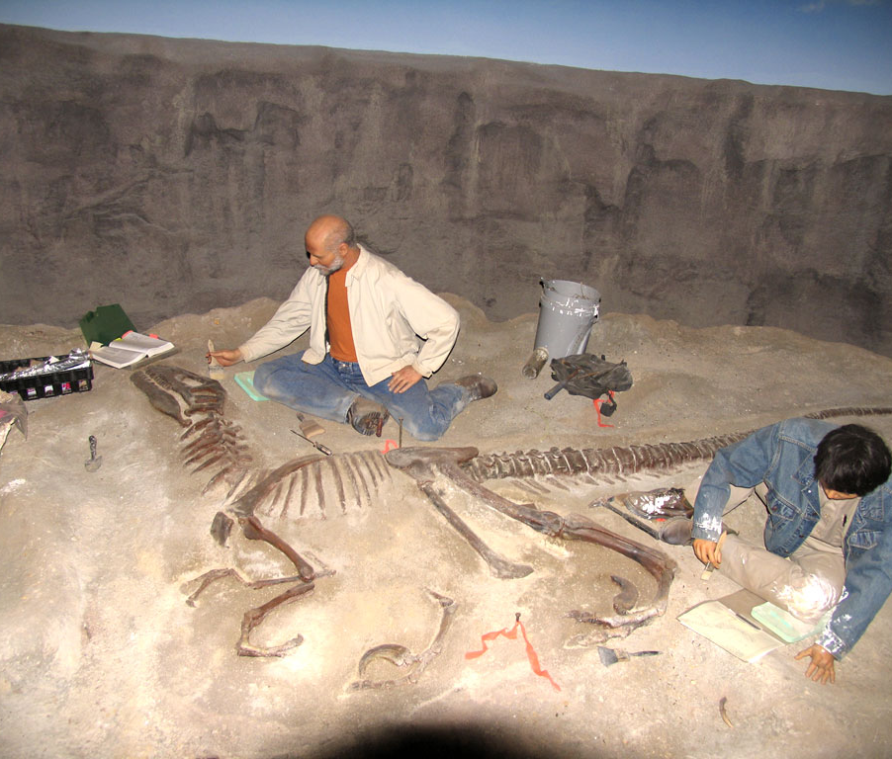
Some scientists study dinosaurs and fossils. This scientist is a paleontologist.

Slide 9
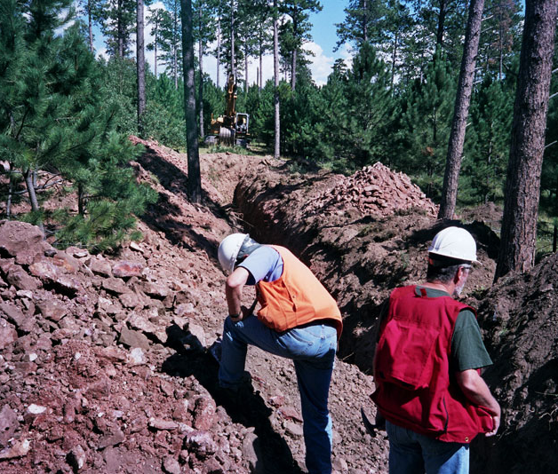
Some scientists study rocks. This scientist is a geologist.

Slide 10
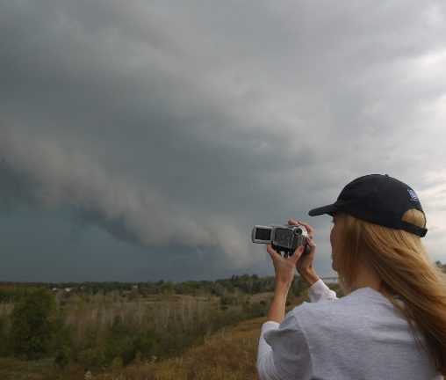
Some scientists study weather. This scientist is a meteorologist.

Slide 11
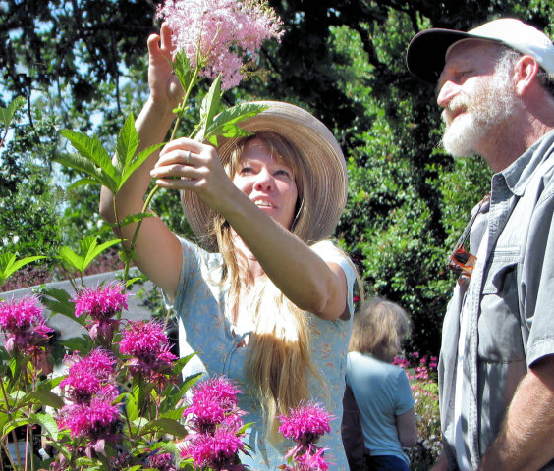
Some scientists study plants. This scientist is a botanist.

Slide 12
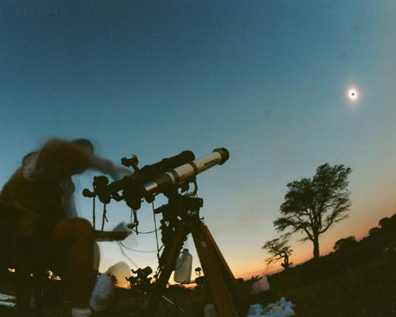
Some scientists study space. This scientist is an astronomer.

Slide 13
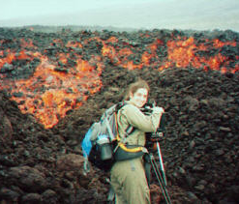
Some scientists study volcanoes. This scientist is an volcanologist.

Slide 14
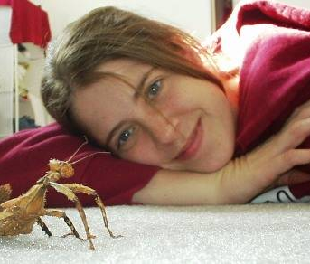
Some scientists study insects. This scientist is an entomologist.

Slide 15
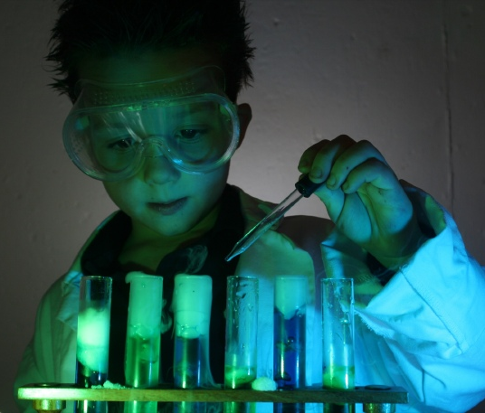
You can be a scientist, too!

